Slide 1
Sequential Logic Circuits
Fall 19
M. E. Zaghloul
Part-I
M.E.Zaghloul

Slide 2
Today Lecture
Definitions of Clock ( review)
Classification of Memory elements
Static latches and Registers
Dynamic Latches and Registers
Chapter 7 in text 7.1,7.2,7.3
We will not cover 7.4 in this class
M.E.Zaghloul

Slide 3
Clock
In VLSI “0” and “ 1” are abstract of charging and discharging of a parasitic capacitances
If charging and discharging occur in discrete moments with clock… CLOCKED LOGIC
M.E.Zaghloul

Slide 4
CLOCK
PHI
Period T
One Phase Clock
PHI_B
M.E.Zaghloul

Slide 5
TWO Phase Clocks
Same Period but shifted
1 2 3 4
4 Epochs for processing
M.E.Zaghloul

Slide 6
Clocked Logic Design
Synchronous that is a common clock for the whole chip could be one phase or two phases clock or even more ..4 phases clock
Asynchronous Each part of the circuit has its own clock
Clock can be external or Built In chip
M.E.Zaghloul

Slide 7
Timing Strategies
In design it is easier to design Synchronous chips
Either single phase or two phases in CMOS
Single phase is convenient for static logic
Domino logic is possible with single phase but it is difficult
Difficult to pipeline using single phase
M.E.Zaghloul

Slide 8
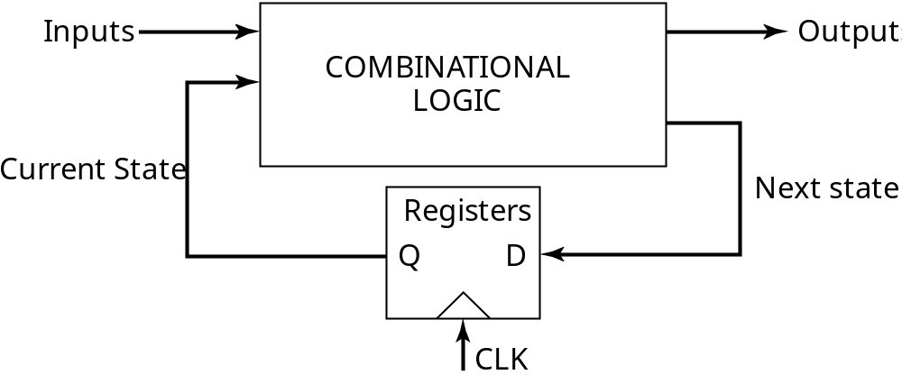

Sequential Logic
2 storage mechanisms
• positive feedback
• charge-based
M.E.Zaghloul

Slide 9
Block Diagram of Finite State Machine
Synchronous Sequential Machine ( global clock)
Output is function of the current input and the current state
Next state is determined by the input and the current state and is fed back to the input
In this class we will discuss CMOS implementation of the above structure
M.E.Zaghloul

Slide 10
Setup time and Hold time
Clock Terminology
Setup time ( t_{su} ) is the time that data inputs (D) must be valid before the clock transition 0—1. Positive edge triggered register
Hold time ( t_{hold} ) is the time that data input remain valid after the clock edge
Data D input is copied to the Q output after the worst case propagation delay from clock to Q (t _{c—q} )
M.E.Zaghloul

Slide 11
Timing Definitions
CLK
t
Register
t
su
t
hold
D
Q
D
DATA
CLK
STABLE
t
t
c
2
q
Q
DATA
STABLE
t
Data D input is copied to the Q output after
the worst case propagation delay from clock to Q (t _{c—q} )

Slide 12
Definitions
Setup time : minimum time the data input must be stable before the clock signal changes
Hold time: minimum time the data input must remain stable after the clock signal changes
M.E.Zaghloul

Slide 13
Classification of Memory Elements
Static Versus Dynamic Memory
Static memories preserve the state by using positive feedback as long as the power is turned on the state stay the same
Static memory are built by connection of the output to the input
Useful when the data will not be updated for extended period of time
M.E.Zaghloul

Slide 14
Classification of Memory Elements
Dynamic memory store data for short period of time, milliseconds.
They are based on charge storage on parasitic capacitors
As discussed before capacitors have to be refreshed periodically to compensate for charge leakage
Dynamic memory tends to be simple high performance very fast and low power.
M.E.Zaghloul

Slide 15
Naming Conventions
In our text:
  a latch is level sensitive
  a register is edge-triggered
There are many different naming conventions
  For instance, many books call edge-triggered elements flip-flops
  This leads to confusion however

Slide 16
Latches Versus Registers
Latch is an essential component . It is level sensitive circuit ( level refer to the clock high or low)
That is a level sensitive circuit that passes D to Q when the clock is high
M.E.Zaghloul

Slide 17
Latch versus Register
Latch
stores data when
clock is low
Register
stores data when
clock rises
D
Q
D
Q
Clk
Clk
Clk
Clk
D
D
Q
Q

Slide 18
Naming Conventions
In our text:
  a latch is level sensitive ( circuit that passes the Data D input to the Q output when the clock signal Hi positive /negative latch)
  a register is edge-triggered ( only sample the input on clock transition that is Zero-to-1 Positive edge triggered or Negative edge triggered)
There are many different naming conventions
  For instance, many books call edge-triggered elements flip-flops
  This leads to confusion
M.E.Zaghloul

Slide 19
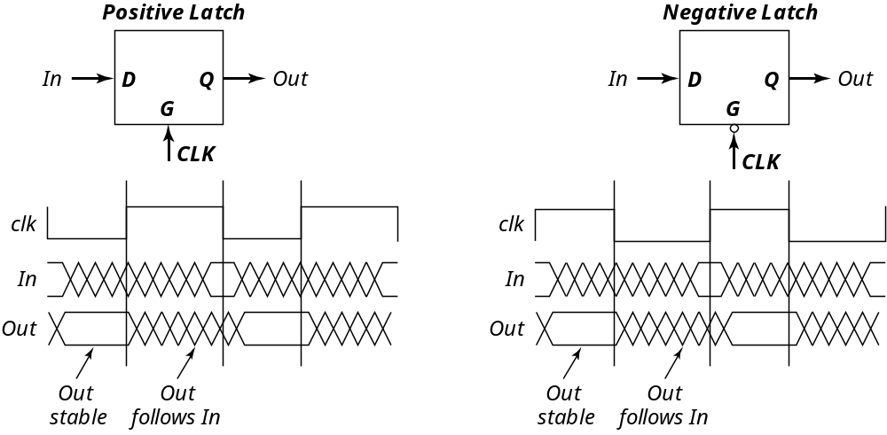
Latches

Slide 20
Level Sensitive- Positive Latch and Negative Latch
Stores the data when the clock edge is high
When the D input passes to the Q output when the clock is high (Positive latch this is called transparent mode.
There are two types of latches positive and negative
M.E.Zaghloul

Slide 21
Physical Process of Latching
Input signal pass when control is high to charge capacitor at node w
D
Q
w
Charge Storage
Setup Time
Hold time
Dynamic Latching
Clk
M.E.Zaghloul

Slide 22
Latches

Slide 23
Latch-Based Design
N latch is transparent
when φ = 0
P latch is transparent
when φ = 1
φ
N
P
Logic
Latch
Latch
Logic

Slide 24
Timing Definitions
Set-Up and Hold time
CLK
t
Register
t
su
t
hold
D
Q
D
DATA
CLK
STABLE
t
t
c
2
q
Q
DATA
STABLE
t

Slide 25
Registers
Only sample the input on clock transition , positive edge or negative edge ( Positive 0—1,or Negative 1—0)
Often built by using latch as primitives in master slave configuration. That is cascading positive and negative latch
M.E.Zaghloul

Slide 26
Latch versus Register
Register Positive
stores data when
clock rises See D versus Q
Latch
stores data when
clock is high
D
Q
D
Q
Clk
Clk
Clk
Clk
D
D
Q
Q
M.E.Zaghloul

Slide 27
Latches and Registers
Latches are transparent while the internal memory is being set from data input
Registers are not transparent, positive edge triggered or negative edge triggered
M.E.Zaghloul

Slide 28
Latches vs Registers
Latches
  level sensitive circuit that passes inputs to Q when the clock is high (or low) - transparent mode
Registers (edge-triggered)
  edge sensitive circuits that sample the inputs on a clock transition
    positive edge-triggered: 0 -- 1
    negative edge-triggered: 1 -- 0
  built using latches (e.g., master-slave registers)
M.E.Zaghloul
Notes:
Positive latch - can also have negative latch with flip definitions
Should insert a slide with figure 7.3 after this one?

Slide 29
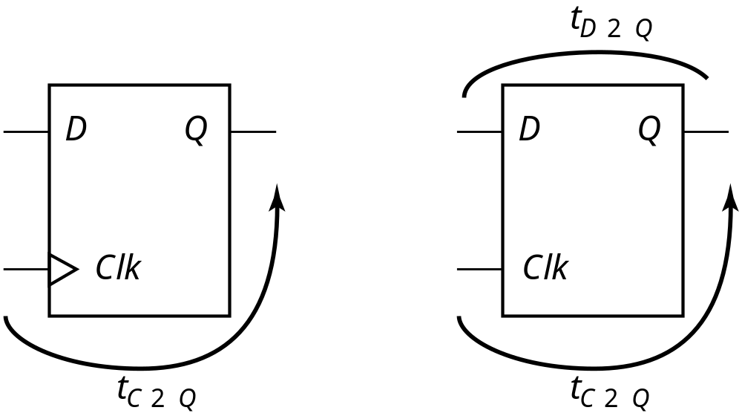
Characterizing Timing
Register and Latch
Notice There are different Delay Time
t_{c-q} propagation delay for data from D to Q when clock is triggered
Register
Latch
M.E.Zaghloul

Slide 30
How to Estimate the
Clock Frequency
To design the clock frequency you need to estimate the delay of each part of the circuit in the design
Estimate the Critical delay of the signal path in the combination part ( worst case delay we defined it)
You should know the typical parameters of the technology layers in the layout to estimate the delay in each part.
Remember it is part of your project to estimate the Clock frequency of your design. You will have to clock the data in for processing, and clock the data output for measuring and verifying
M.E.Zaghloul

Slide 31
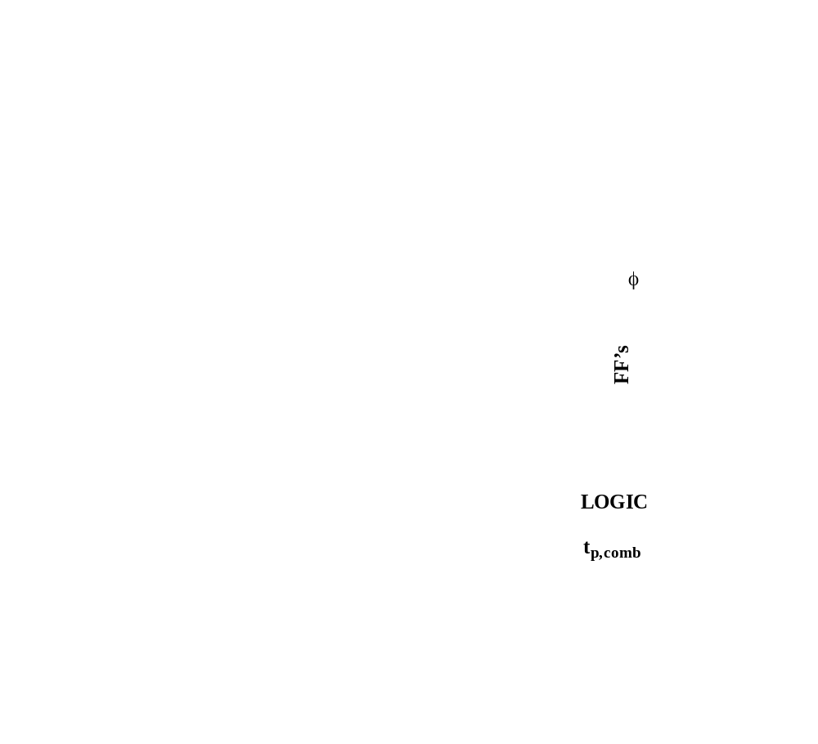
Maximum Clock Frequency
How to calculate the clock Period
Register
D
t_{clk-Q} + t_{p,comb} + t_{setup} < T ( T is the clock period))
M.E.Zaghloul

Slide 32

Maximum Clock Frequency
t_{clk-Q} + t_{p,comb} + t_{setup} = T

Slide 33
Data Path System
How to calculate the Maximum clock cycle needed
Based on the maximum delay in the critical path of the system
If you are designing an adder you have to find the critical path and estimate the delay (combinations)
M.E.Zaghloul

Slide 34
Assume that you have Combination Logic Design
Let the combination logic design is CL, with delay from input to output T_{d}
We need to clock the data in at specific time and to clock the data out at specific time
This is to help us read input in to the chip, and read output from the chip out at specific time, what is the clock cycle?
M.E.Zaghloul

Slide 35
Data Path System
Arithmetic Block
Data
REG
RE
G
CL
T_{q}
T_{d}
T_{s}
CLK
Clock is external to the Chip
This is good example of your project
T_{C} > T _{q} + T_{d} + T_{s}
Clock Cycle
M.E.Zaghloul

Slide 36
Your Project
Most of the projects I have seen are combinational logic
You will have to add Input Register and Output register as explained in the previous slide
You will have to determine the clock frequency needed for your design
M.E.Zaghloul

Slide 37
Break
M.E.Zaghloul

Slide 38
Sequential Circuits Design Style
We learned That we have TWO types of storage devices:
Edge triggered storage element we call Register
Latch storage device level sensitive
Third Type is Bistable circuits ( two stable states circuits)
Any bistable circuit is usually formed by cross coupling of gates ( named flip-flop)
M.E.Zaghloul

Slide 39
Bistable Circuits
Third Type of storage elements are Bistable Circuits
Bistable means two stable states of the circuit ( two possible configuration)
Examples are Cross Coupling of gates usually called Flipflop
M.E.Zaghloul

Slide 40
The Regenerative Property
V_{i1}
V_{o1}
V_{i2}
V_{o2}
cascaded inverters
A
If the gain in the transient region is larger than 1, only A and B are stable operation points. C is a metastable operation point.
V_{i2} = V_{o1}
C
B
V_{i1} = V_{o2}
Bistable circuit has two stable states. In absence of any triggering the circuit remains in asingle state
M.E.Zaghloul
Notes:
bistability principle - a circuit having two stable states that represent 0 and 1
Consider just two inverters - VTC of first inverter and second inverter (later plot is rotated to accentuate that Vi2 = Vo1). Resulting circuit has just three possible operation points (A, B and C). A small deviation from the bias point C (e.g., from noise) is amplified and regenerated around the circuit loop until either point A or B is reached.
A and B are stable operation points. At these points, the loop gain is much smaller than unity.

Slide 41
Biostable Circuits
Example Two inverters Cross Coupled
Three points of operation A, B, and C, at the transfer function
At C the gain is larger than 1, unstable state.
At A and B a stable operating point, gain is much smaller than 1
The unstable state effect is demonstrated by any small deviation around C ( noise or other) will be amplified and the bias point moves from C untill it reaches A or B
M.E.Zaghloul

Slide 42
Bistable Circuits
Can serve as memory. Two inverters cross coupled
Circuit with two stable state which is logic state either 1 or 0
To change from one state to the other by changing the loop gain , by forcing the loop gain to be greater than one, by applying trigger pulse and the circuit moves to the other state.
M.E.Zaghloul

Slide 43
Bistable Circuits
V_{i1}
The cross-coupling of two inverters results in a bistable circuit (a circuit with two stable states)
V_{i2}
Have to be able to change the stored value by making A (or B) temporarily unstable by increasing the loop gain to a value larger than 1
  done by applying a trigger pulse at V_{i1} or V_{i2}
  the width of the trigger pulse need be only a little larger than the total propagation delay around the loop circuit (twice the delay of an inverter)
Two approaches used
  cutting the feedback loop (mux based latch)
  overpowering the feedback loop (as used in SRAMs), new value is forced into the cell by overpowering the stored value
M.E.Zaghloul
Notes:
cutting the feedback loop is the most popular in today’s latches

Slide 44
Example of Bistable
Using cross coupled NOR gates
Add clock to have clock gating condition
The following is an example
M.E.Zaghloul

Slide 45
Review (ECE2 2140): Clocked D Latch
D
!Q
Q
D
D Latch
Q
clock
transparent mode
clock
clock
hold mode
M.E.Zaghloul

Slide 46
Static vs Dynamic Storage
Static storage
  preserve state as long as the power is on
  have positive feedback with an internal connection between the output and the input
  useful when updates are infrequent (clock gating, conditional clock)
Dynamic storage
  store state on parasitic capacitors
  only hold state for short periods of time (milliseconds)
  require periodic refresh
  usually simpler, with higher speed and lower power
M.E.Zaghloul
Notes:
clock gating - conditional clocks - where the clock is turned off for unused modules to save on power

Slide 47
MUX Based Latches
Change the stored value by cutting the feedback loop
feedback
feedback
1
0
Q
Q
D
0
D
1
clk
clk
Negative Latch
Positive Latch
Q = clk & Q | !clk & D
Q = !clk & Q | clk & D
transparent when the clock is low
transparent when the clock is high
M.E.Zaghloul
Notes:
Nonratioed latch – sizing of the devices affects performance and is not critical to functionality

Slide 48
TG MUX Based Latch CMOS Implementation
clk
Clk = 1, D=Q
Clk = 0, Q=Q
Q
!clk
input sampled
(transparent mode)
D
clk
clk
D
D Latch
Q
!clk
clk
feedback
(hold mode)
M.E.Zaghloul
Notes:
Positive latch – latch is transparent (D is copied to Q) when clk is high (bottom transmission gate is on)
clk load is two transistors (and two for !clk) = clock load of 4
Also have the problem of having to generate both clk and !clk (nonoverlapping clocks)

Slide 49
TG MUX Based Latch CMOS Implementation
Positive latch – latch is transparent (D is copied to Q) when clk is high (bottom transmission gate is on)
clk load is two transistors (and two for !clk) = clock load of 4
M.E.Zaghloul

Slide 50
NMOS Pass Transistor MUX Based Latch Implementation
clk
!Q
D
Q
input sampled
(transparent mode)
!clk
Reduced clock load, but threshold drop at output of pass transistors so reduced noise margins and performance
clk
!clk
feedback
(hold mode)
M.E.Zaghloul
Notes:
Positive latch – latch is transparent (D is copied to Q) when clk is high
Have reduced clock load by replacing transmission gates with pass transistors, but that impacts both noise margin and switching performance and causes static power dissipation due to threshold drop.
clk load is one transistors (and one for !clk) = clock load of 2
Still have the problem of having to generate both clk and !clk

Slide 51
Edge Triggered Register
To build edge triggered FF combine two level sensitive latches
This will be in a master slave configuration
The register consists of cascading a negative latch (we call master) with positive latch ( we call slave)
A MUX based latch is used in this particular case
M.E.Zaghloul

Slide 52
Master Slave Based ET Register
D
D FF
Q
0
0
1
clock
1
Q
Q
1
1
Q_{M}
D
Q_{M}
D
0
0
clk
clk
clk
Slave
Slave
D
Master
Master
clk = 0 transparent hold
Q_{M}
clk = 0 -- 1 hold transparent
Q
M.E.Zaghloul
Notes:
On low phase of clock, master is transparent and D input is passed to master stage output QM. Slave is in hold mode, keeping its previous value using feedback.
During the rising edge of the clock, the master stops sampling and goes into hold mode, the slave starts sampling coping QM to its output.
The value of Q is the value of D right before the rising edge of the clock achieving a POSITIVE EDGE TRIGGERED effect.
Can build a negative edge triggered by switching the order of master and slave (master positive, slave negative)

Slide 53
MS ET Implementation
Master
Slave
I₂
T₂
I₃
I₅
T₄
I₆
Q
Q_{M}
I₁
T₁
I₄
T₃
D
clk
clk
!clk
M.E.Zaghloul
Notes:
For class handout

Slide 54
MS positive edge Triggered Implementation
Master
Slave
I₂
T₂
I₃
I₅
T₄
I₆
Q
Q_{M}
I₁
T₁
I₄
T₃
D
clk
Note clk is generated locally
master transparent
slave hold
master hold
slave transparent
clk
!clk
M.E.Zaghloul
Notes:
For lecture
Note that !clk is generated locally
20 transistors (plus clock inverter) – 8 clock loads (4 on clk and 4 on !clk) (can ignore the buffer inverter overhead since it can be amortized over multiple register bits)

Slide 55
Drawback of Transmission gate Register
High capacitive load presented to the clock at the transmission gate
To reduce the clock load the feedback transmission gate could be eliminated
M.E.Zaghloul

Slide 56
Reduced Load MS ET FF
Clock load per register is important since it directly impacts the power dissipation of the clock network.
Can reduce the clock load (at the cost of robustness) by making the circuit ratioed
clk
!clk
I₁
I₃
Q_{M}
D
T₁
T₂
Q
I₂
I₄
!clk
clk
reverse conduction
  to switch the state of the master, T₁ must be sized to overpower I₂
  to avoid reverse conduction, I₄ must be weaker than I₁
M.E.Zaghloul
Notes:
12 transistors with clock load of 4 (2 on clk and 2 on !clk) – but now ratioed design (and thus less robust)
T1 must overpower I2 to switch the state of the cross-coupled inverters I1 and I2. But want to use minimum (or close to it) transistors in T1 and T2 to keep clock load small (to reduce power dissipation in flipflops and in the clock distribution network). Thus, probably want to downsize the transistors in I1 (making them longer and thus weaker).
Another problem is reverse conduction is possible – second stage can affect the state of the first latch. When slave (second latch) is on, it is possible for a combination of T2 and I4 to influence the data stored in I1&I2. As long as I4 is a weak device, this is not a problem

Slide 57
Avoiding Clock Overlap
CLK
X
CLK
Q
D
A
B
CLK
CLK
We assume that
CLK! Is perfect
Inversion of Clk
That is delay in
generating inverted
Clk is zero
(a) Schematic diagram
CLK
CLK
(b) Overlapping clock pairs

Slide 58
Clock overlap
If there is clock overlap it can cause failure of the signal
Clk and Clk! Could be both high for short period of time ( overlap period) this will cause what we call race condition
The problem can be solved using two phases PH1 and PH2 clock keeping overlap time very large
M.E.Zaghloul

Slide 59
Non-Ideal Clock Signals
We assumed the clock and clock_B are ideal signal
No delay in wires routing the clock
Perfect inversion
No Delays due to load capacitances
This is not the real world
M.E.Zaghloul

Slide 60
Clock Skew
Due to delay in clock signal misalignment between master clock and local clock
Problem is serious when using single clock on the chip
Master Clock
Local Clock
M.E.Zaghloul

Slide 61
Non-Ideal Clocks
clk
clk
!clk
!clk
Ideal clocks
Non-ideal clocks
clock skew
1-1 overlap
0-0 overlap
M.E.Zaghloul
Notes:
Clk and !clk are never perfect inversions of one another – must generate !clk and route both signals (variations can exist in the wires used to route the two clock signals and load capacitances can vary)
Clock skew can result in clock overlap

Slide 62
Clock Skew
The skew can assume both positive and negative values depending on the direction of the data transfer
The designer has to account for the worst case skew condition
M.E.Zaghloul

Slide 63
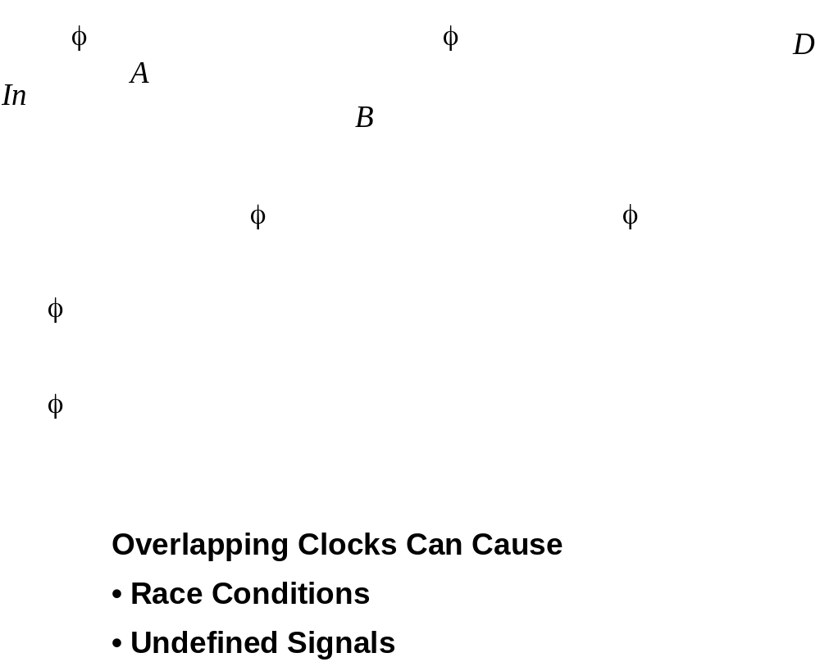
Master-Slave Flip-Flop
M.E.Zaghloul
Notes:
When Phi and Phi (b) overlap Node A can become undefined as it is driven by both In and B when Phi and Phi(b) are simultaneously high
The input Incan propagate through both the master and slave and may cause race

Slide 64
Example of Clock Skew Problems
X
!clk
Q
clk
P₁
A
P₃
I₃
I₄
!Q
D
I₁
I₂
B
P₂
P₄
!clk
clk
Race condition – direct path from D to Q during the short time when both clk and !clk are high (1-1 overlap)
Undefined state – both B and D are driving A when clk and !clk are both high
Dynamic storage – when clk and !clk are both low (0-0 overlap)
M.E.Zaghloul
Notes:
When clock goes high, slave should go into hold mode. But since clk and !clk are both high for a short period of time there is a direct path from D to Q. So data output could change on rising edge (not this is a negative et device!). Race condition where value of Q is a function of whether the input D arrives at node X before or after the falling edge of !clk.
Node A is driven by both D and B when clk and !clk are both high resulting in an undefined state

Slide 65
Pseudostatic two-phase D register
The problem can be solved by using two nonoverlapping clocks and by keeping the nonoverlap time large
During the nonoverlap time both Clk1 and Clk2 are low and the feedback loop is open, the input is disconnected
The leakage current may destroy the state if the nonoverlap holds for long time.
M.E.Zaghloul

Slide 66
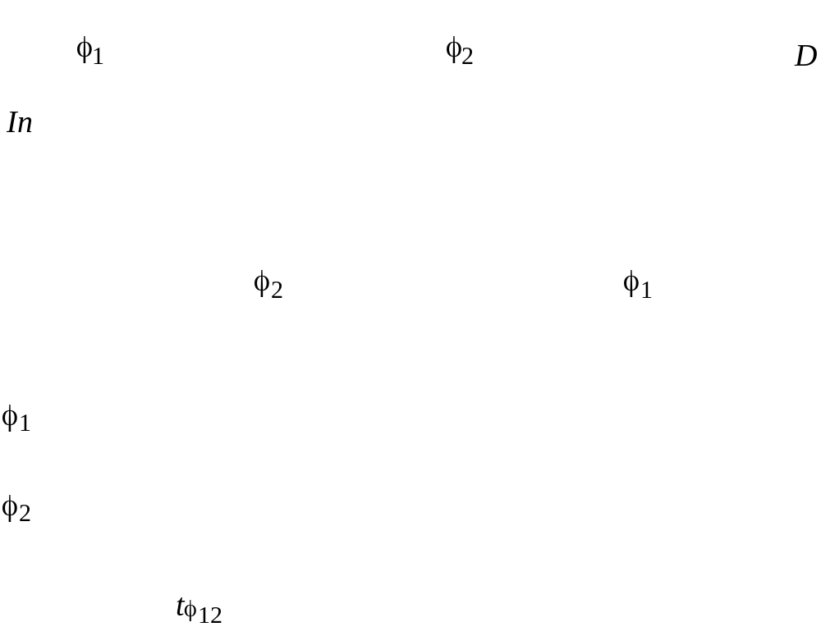
2 phase non-overlapping clocks
Solution
M.E.Zaghloul

Slide 67
Clock Skew
Two Phases solution
The most obvious and practical solution to ensure that the clock skew is bounded
This can be done by careful analysis and design of the clock distribution network
Note that the absolute value of the skew is irrelevant
What counts is the relative skew between communicating registers
M.E.Zaghloul

Slide 68
Pseudostatic Two-Phase ET FF
X
clk2
Q
clk1
P₁
A
P₃
I₃
I₄
!Q
D
I₁
I₂
B
P₂
P₄
clk2
clk1
Use Two Phase nonoverlapping
dynamic
storage
master transparent
slave hold
clk1
master hold
slave transparent
t_{non_overlap}
clk2
M.E.Zaghloul
Notes:
Keep clock nonoverlap time large enough that no overlap occurs even in the presence of clock skew
During the nonoverlap time, the ff is in the high-impedance state – the feedback loop is open (the loop gain is zero) and the input is disconnected. Leakage will destroy the state if this condition holds for too long – hence the name pseudostatic (the register employs a combination of static and dynamic storage approaches depending upon the state of the clock). Don’t want to stop the clocks when both are low!!

Slide 69
Two Phase Clock Generator
A
clk1
Possible implementation
Clk1 and Clk2
clk
B
clk2
clk
B
A
clk1
clk2
M.E.Zaghloul

Slide 70
Clock Skew
The designer can govern the clock distribution network through a number of design parameters
- Interconnect material used
-Shape of clock network
- clock driver and the buffering scheme used
- Load of clock line Fanout
- Rise and fall time
M.E.Zaghloul

Slide 71
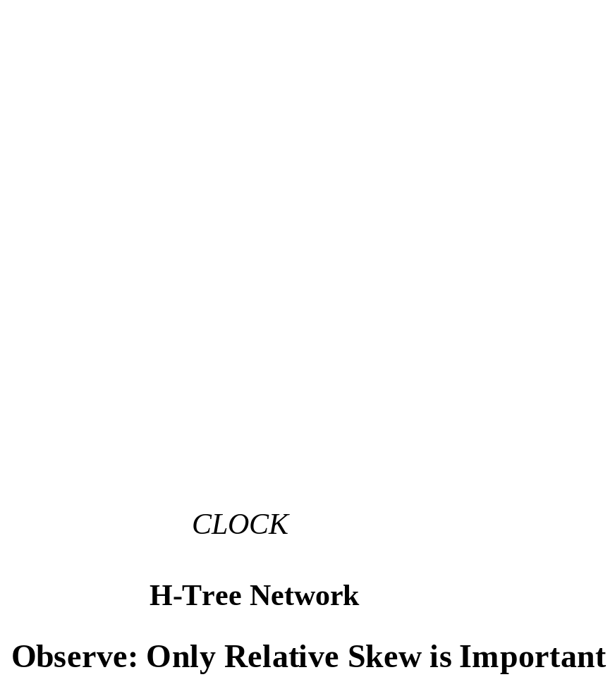
Clock Distribution
4x4 array cells
Clock signal is delayed by equal amount
M.E.Zaghloul

Slide 72
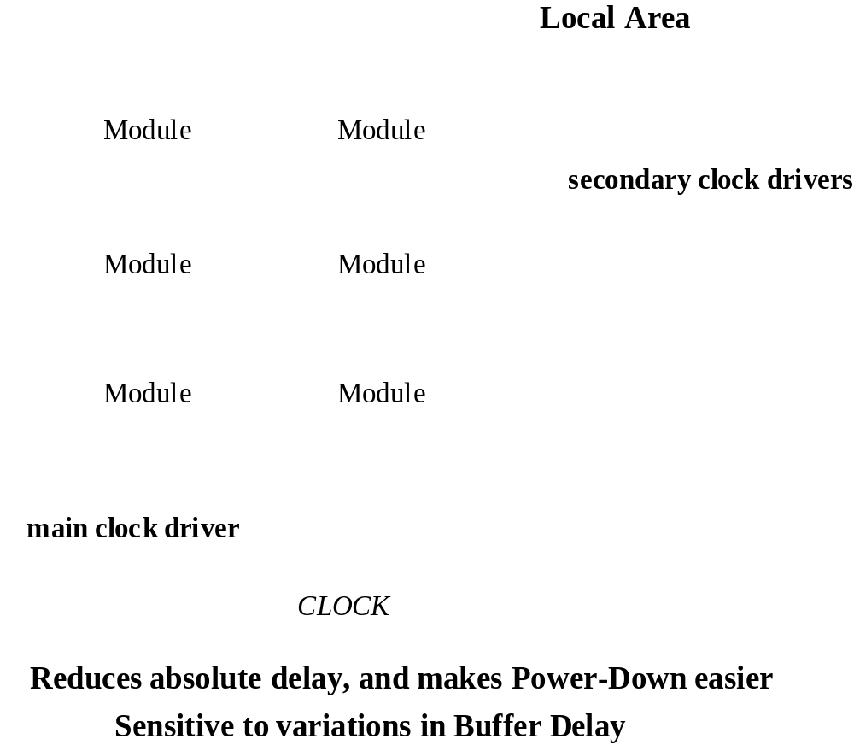
Clock Network with Distributed Buffering
M.E.Zaghloul

Slide 73
6 Transistor CMOS SR(Set Reset) Latch
clk
clk
R
S
clk
clk
M2
M4
Q
M6
S
M5
!Q
R
M1
M3
M.E.Zaghloul
Notes:
Problems with noise margins and static power consumption due to threshold drop across pass transistors
Once again, sizing is important - especially M5 and M6
Will see this structure again when we talk about SRAMs!!

Slide 74
Review: Sequential Definitions
Static versus dynamic storage
  static uses a bistable element with feedback (regeneration) and thus preserves its state as long as the power is on
  static is preferred when updates are infrequent (clock gating)
  dynamic stores state on parasitic capacitors so only holds the state for a period of time (milliseconds) and requires periodic refresh
  dynamic is usually simpler (fewer transistors), higher speed, lower power
  dynamic storage requires periodic refresh of the value
Latch versus flipflop
  latches are level sensitive with two modes: transparent - inputs are passed to Q and hold - output stable
  fliplflops are edge sensitive that only sample the inputs on a clock transition
M.E.Zaghloul
Notes:
Dynamic storage requires periodic refresh of the value.
Reading the value of the stored signal from a capacitor without disrupting the charge requires the availability of a device with a high input impedance

Slide 75
Dynamic Latches and Registers
Storage in Static sequential relies on the concept of bistable element, stored value remains as long as the supply voltage is applied
Dynamic storage is based on charge storage on parasitic capacitance, charge storage can be kept for limited time and periodic refresh of the value is necessary
M.E.Zaghloul

Slide 76
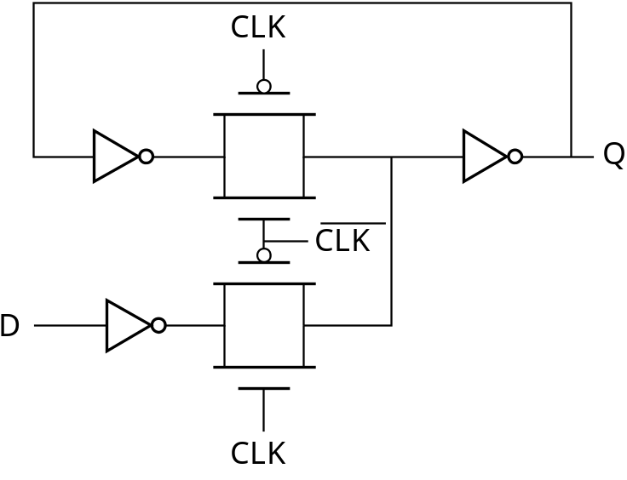
Storage Mechanisms
Static
Dynamic (charge-based)
CLK
D
Q
CLK

Slide 77
Example of Dynamic ET Flipflop
master
slave
!clk
clk
Q_{M}
D
T₁
I₁
T₂
I₂
Q
What is C1 due to?
C₁
C₂
clk
!clk
t_{su} =
t_{hold} =
t_{c-q} =
t_{pd_tx}
zero
master transparent
slave hold
2 t_{pd_inv} + t_{pd_tx}
clk
!clk
master hold
slave transparent
M.E.Zaghloul
Notes:
C1 is the gate cap of I1, the junction cap of T1 and the overlap gate cap of T1
8 transistors, so very efficient
tsetup is delay of the transmission gate (time it takes C1 to sample D input)
hold time is zero since T1 is turned off on the clock edge so further input changes are ignored
tpFF is two inverter delays plus the delay of T2
Remember – dynamic nodes (C1 and C2) only hold their state so long, so ff has to be refreshed periodically to prevent state loss due to charge leakage

Slide 78
Dynamic Transmission gate ET-R
The Setup time is simply the delay in the TG
The Hold time is approximately zero, since the TG is turned on at the clock edge
The propagation delay after the clock is triggered is two inverters delay plus TG delay
M.E.Zaghloul

Slide 79
Dynamic ET FF Race Conditions
!clk
clk
Q_{M}
D
T₁
I₁
T₂
I₂
Q
C₁
C₂
clk
!clk
0-0 overlap race condition
t_{overlap0-0} < t_{T1} +t_{I1} + t_{T2}
clk
!clk
1-1 overlap race condition
t_{overlap1-1} < t_{hold}
M.E.Zaghloul
Notes:
clock overlap leads to race conditions
1-1 race fixed by enforcing a hold time - data must be stable during the high-high overlap period
0-0 race fixed by making sure there is enough delay between D and C2 so that new data sampled by the master does not propagate to the slave (can be ensured by enforcing appropriate setup time)

Slide 80
Dynamic Two-Phase ET FF
clk1
clk2
Q_{M}
D
T₁
I₁
T₂
I₂
Q
C₁
C₂
!clk1
!clk2
Keep clock nonoverlap time large enough that no overlap occurs even in the presence of clock skew
master transparent
slave hold
clk1
t_{non_overlap}
clk2
master hold
slave transparent
M.E.Zaghloul
Notes:
Keep clock nonoverlap time large enough that no overlap occurs even in the presence of clock skew
But now have 4 clock signals to route!

Slide 81
Pseudostatic Dynamic Latch
Robustness considerations limit the use of dynamic FF’s
  coupling between signal nets and internal storage nodes can inject significant noise and destroy the FF state
  leakage currents cause state to leak away with time
  internal dynamic nodes don’t track fluctuations in V_{DD} that reduces noise margins
A simple fix is to make the circuit pseudostatic
!clk
Adding a weak feedback inverter to each latch comes at a slight cost in delay and power consumption, but it improves noise immunity significantly
D
clk
Add above logic added to all dynamic latches
M.E.Zaghloul
Notes:
adding a weak feedback inverter to each latch
comes at a slight cost in delay (adds to the capacitive load) and power consumption, but it improves noise immunity significantly

Slide 82
Examples of Flip Flop
ECE2140
M.E.Zaghloul

Slide 83
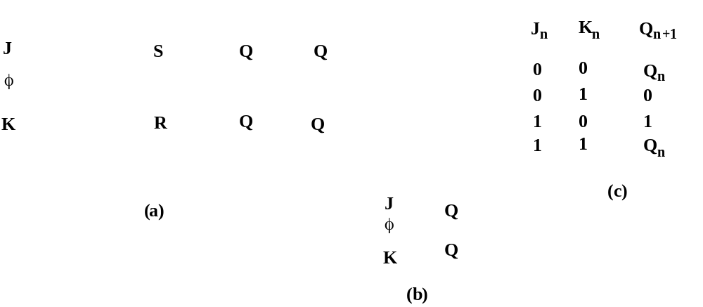
JK- Latch
M.E.Zaghloul

Slide 84
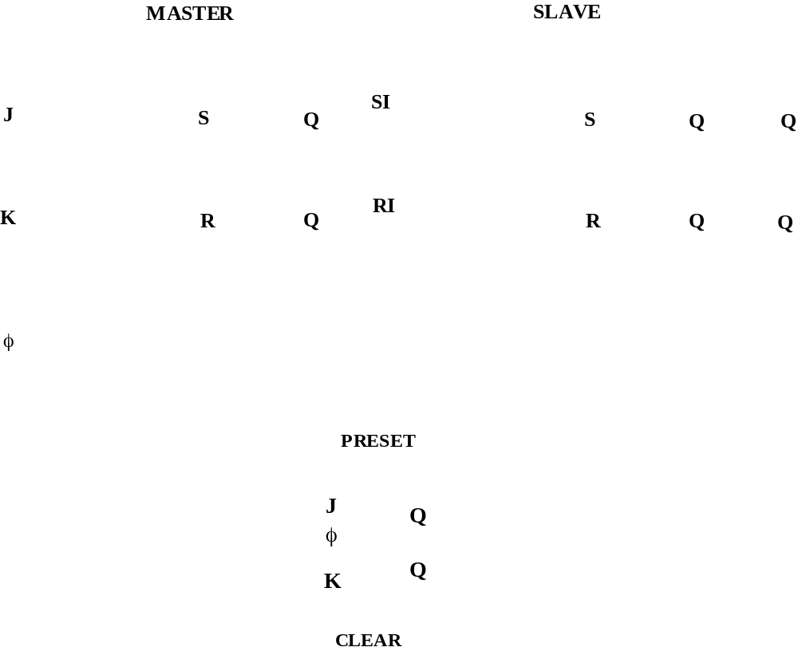
Master-Slave JK Register
M.E.Zaghloul

Slide 85
Example (ECE2140): SR Latch
S | R | Q | !Q
0 | 0 | Q | !Q | memory
1 | 0 | 1 | 0 | set
0 | 1 | 0 | 1 | reset
1 | 1 | 0 | 0 | disallowed
S
!Q
Q
R
M.E.Zaghloul

Slide 86
Key message
Synchronization and timing are among the most important challenges facing digital designer
This is especially important in interconnecting synchronous and asynchronous components and the decade of deep submicron designs
M.E.Zaghloul

Slide 87
Next Class
Next Class MIDTERM October 31st
Nov 7th Dynamic latches and Registers
Clock skew Insensitive master slave design
Pipeline approach to sequential circuits design
In this chapter we are not covering sections 7.4, and 7.6
M.E.Zaghloul

